Slide 1
Arduino Programming using C
Digital inputs and outputs
Analog inputs and outputs
Making decisions with ‘if’
Loops
Goal: learn enough to understand the modules and get you started on writing your own C programs

Slide 2
digitalRead and digitalWrite
Suppose we want to turn on LED connected to pin 8
digitalWrite(8,HIGH); //sets pin 8 to 5V
digitalWrite(8,LOW); //sets pin 8 to 0V
Now suppose we want to read the voltage present on pin 9
int x = digitalRead(9);
Declares variable x to be an integer type
Reads pin 9 voltage
Stores either LOW or HIGH into x
Actual values stored is either 0 or 1
Output
Input

Slide 3
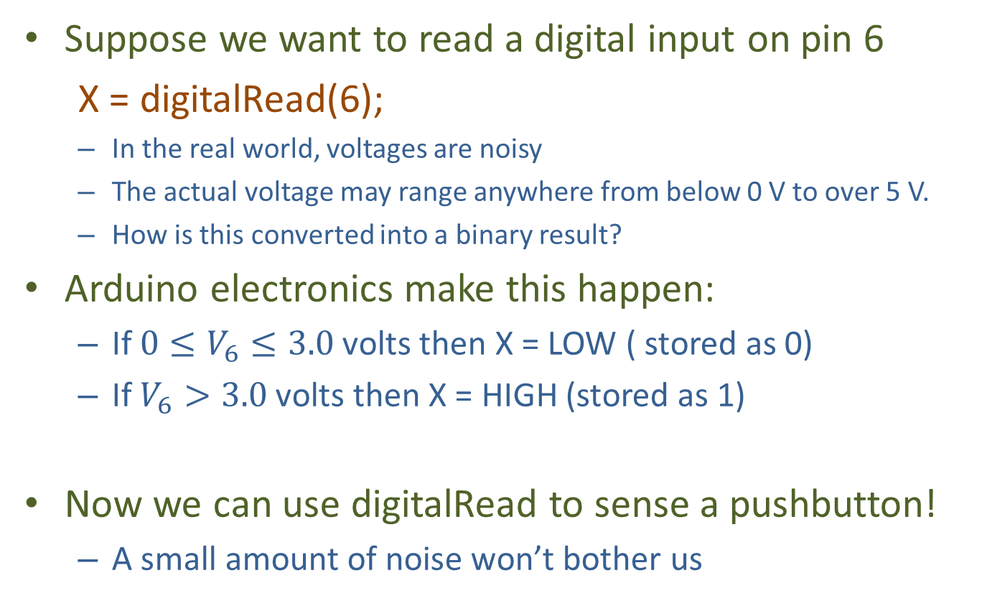
Meaning of LOW and HIGH
Suppose we want to read a digital input on pin 6
X = digitalRead(6);
In the real world, voltages are noisy
The actual voltage may range anywhere from below 0 V to over 5 V.
How is this converted into a binary result?
Arduino electronics make this happen:
If $0≤V_{6}≤3.0$volts then X = LOW ( stored as 0)
If $V_{6}>3.0$ volts then X = HIGH (stored as 1)
Now we can use digitalRead to sense a pushbutton!
A small amount of noise won’t bother us
No noise
5V
0V
Noisy
5V
0V

Slide 4
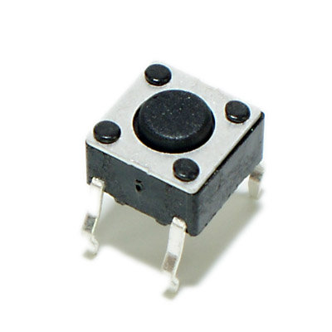
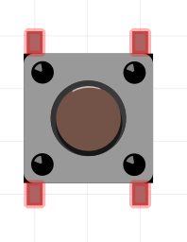
Push Button Switch
Pushing button connects left 2 pins to right 2 pins

Slide 5
How to use a Push Button switch A difficulty:
V₃
If you push the button:
Voltage on Pin 3: V₃= 0 = LOW
If you don’t push the Button:
V₃ is not defined
This is called a “floating input”
Gives random results.
Sometimes HIGH, sometimes LOW
This is Bad.
Pin 3
Switch
Gnd

Slide 6
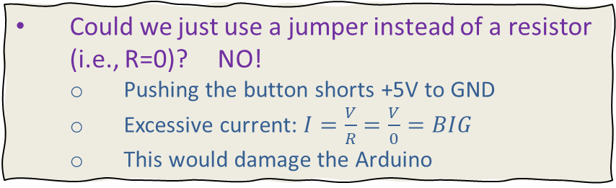
Solution: Use a “Pull-up” resistor
+5 V
Now, if you don’t push the button:
V is “pulled up” toward +5V (HIGH)
It’s not quite 5V but close enough
The input is no longer floating
If you do push the button:
V = 0 (LOW)
Nothing is floating - Problem is solved!!!!
Pull-up Resistor R
Arduino pin
V
Switch
Could we just use a jumper instead of a resistor (i.e., R=0)? NO!
Pushing the button shorts +5V to GND
Excessive current: $I=\frac{V}{R}=\frac{V}{0}=BIG$
This would damage the Arduino
Gnd

Slide 7
Built-In Pull-up Resistor
Arduino has built-in pull-up resistors
So we don’t need to put one into our circuit
They are optional. Activate using:
pinMode(PinNumber, INPUT_PULLUP);
Just remember:
Button pushed: digitalRead is LOW
Button not pushed: digitalRead is HIGH

Slide 8
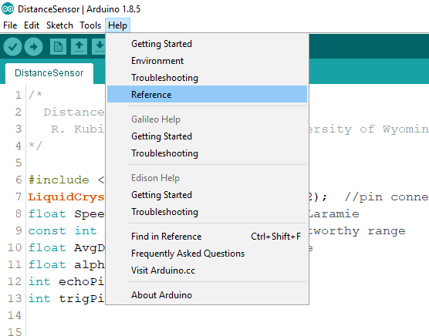
Getting Help
Use Help->Reference
Click Here for all terms
or Highlight term and click here

Slide 9
if statement
This is how computers make decisions
E.g., is a sensor value above a certain number?
The format for an if test is:
Format
Example
if (Condition True)
{
statements
}
if (someVariable > 50)
{
digitalWrite(LEDpin,HIGH);
}

Slide 10
if details
General form of “if statement”: if (Boolean expression) {bunch of statements}
“Boolean” means its value is true or false
Examples of Boolean expressions:
X==Y meaning: X equals Y
X!=Y meaning: X not equal to Y
X>=Y meaning: X greater or equal to Y
X==Y && W==3 meaning: “&&” is AND
X>Y || X==5 meaning: “||” is OR

Slide 11
Hands On
Objective: Learn about IF statements
Build simple circuit with switches and LEDs
Experiment with different uses of “if” statement

Slide 12
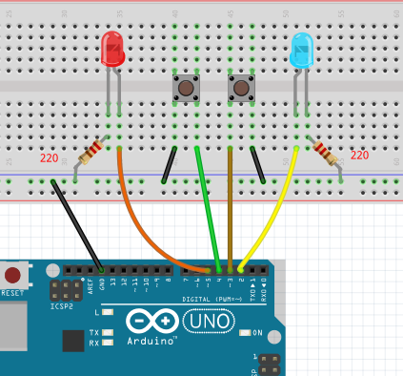
Build This Circuit
Hands On
Pin 5 – left LED
Pin 4 – left button
Pin 3 – right button
Pin 2 – right LED

Slide 13
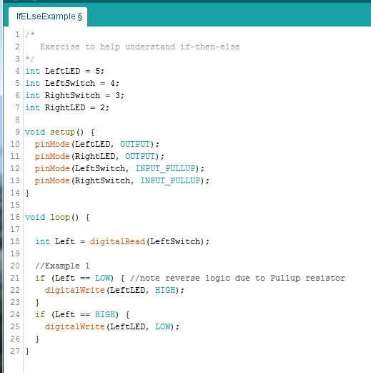
Your Assignment:
Hands On
Open IfExample.ino from Templates folder
Edit to look like this
Understand the sketch
Upload the program
Does it do what you think it should do?

Slide 14
What does “=“ mean?
Hands On
In Algebra, X=Y means that X and Y have same value
The statement X = X+1 is not meaningful
In computers X=X+1 means:
Store the value of X+1 back into location X
E.g., if 15 is initially stored in location X
First compute X+1, which gives 16
Store this value into memory location X
Now 16 is stored in memory location X

Slide 15
What does “==“ mean?
Hands On
Consider the C statement: if (Left== LOW) { do something}
“Left==LOW” is called a “Boolean expression”
It is true if the value in memory location Left is LOW
It is false otherwise
Summary
X=Y+W; //stores the value of Y+W into variable X
X==Y+W; //is true if the value of X equals the value Y+W //Does not store any value into X

Slide 16
if Statement Practice
Hands On
Modify your code to accomplish following:
Right button
When pushed, right LED is ON
When NOT pushed, right LED is OFF
Left button
When pushed, left LED is OFF
When NOT pushed, left LED is ON
Solution is in IfPractice.ino

Slide 17
Several Forms of IF
Hands On
if (x >= y) {
digitalWrite(5,HIGH);
}
if (x > y) {
digitalWrite(5,HIGH);
}
else {
digitalWrite(4,LOW);
}
if (x > y) {
digitalWrite(5,HIGH);
}
else if (x==y){
digitalWrite(4,LOW);
}
else {
digitalWrite(4,LOW);
digitalWrite(5,LOW);
}
if (x > y) {
digitalWrite(5,HIGH);
}
else if (x==y){
digitalWrite(4,LOW);
}
//no action taken if x<y

Slide 18
Practice Assignment
Hands On
Modify your sketch to read the right button using “digitalRead(pin #);”
Then use one of the if-else statements on the previous slide to accomplish the following
When right button pressed
The right LED will illuminate
The left LED is off
When released (this is the “else” part)
The left LED will illuminate
The right LED is off
Solution in IfElse.ino

Slide 19
If you have time (or do at home)
Hands On
Modify your sketch using two if-else if statements to do following
Condition to turn on Left LED (called an “inclusive OR”)
If left OR right OR both buttons pressed
Otherwise, left LED is off
Condition to turn on Right LED (called an “exclusive OR”)
If either Left or Right button pressed (but not both)
If both buttons pressed OR no buttons pressed, then LED is OFF (use if–else, or combine conditions into one if)
Solution is in: LastIfELseExample.ino
Notes:
There are many solutions
Suppose we start with:
int Left = digitalRead(LeftSwitch);
int Right = digitalRead(RightSwitch);
Exclusive OR can be done like this:
If (Left==LOW && Right==HIGH) digitalWrite(pin,HIGH);
Else if (Right==LOW && Left==HIGH) digitalWrite(pin,HIGH);
Or like this:
If (Left==LOW && Right==HIGH || Right==LOW&&Left==HIGH) digitalWrite(pin,HIGH);
Or simplest: if (Left != Right) digitalWrite(pin,HIGH); else digitalWrite(pin,LOW);

Slide 20
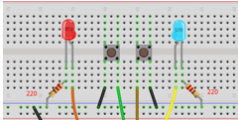
Repeating Statements with “Loops”
While loop: Repeat a group of statements as long as condition remains true
E.g., Turn on LED light as long as temp > 90°
For loop: Repeat statements a fixed number of times
E.g., blink LED exactly ten times
The following experiments use the same circuit we’ve been using (2 switches and 2 LEDs)

Slide 21
We begin with the while loop
Example 0:
var = 0; while(var < 200){ //These statements execute 200 times var++; //this is short hand for: var = var + 1; }

Slide 22
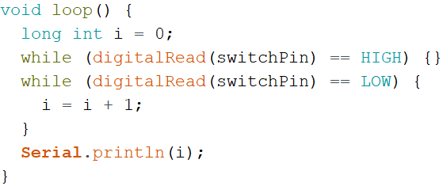
Example 1: Count # Times Thru Loop
Arduino runs at 16 million instructions/second
This program counts the number of instructions executed while you hold down the pushbutton
Open the sketch: LoopCounter.ino and watch the monitor as you push the button

Slide 23
Example 2: Measuring Time Duration
Measuring duration of an event is a common application
E.g., how long has a button been pushed?
Before proceeding, here are two useful facts:
Here’s a useful function: “millis()” gives # milliseconds since Arduino turned on
New variable type (use this when numbers get really big): “long int x;” or “long x;”
“int x;” declares a 16 bit integer variable
Handles values in the range: -32768 to +32767
“long x;” declares a 32 bit integer variable
Handles values in the range: -2.14 billion to +2.14 billion

Slide 24
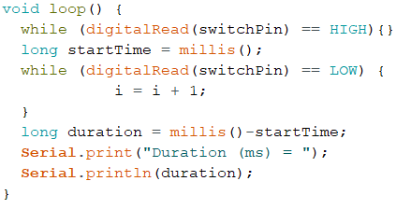
The Sketch
Modify your program to measure duration button is pushed (in milliseconds, or m.s.)
Changes to make
Complete sketch in LoopTimer.ino

Slide 25
Hands On
Objective: Work through Examples 1 and 2 to help you understand “while” statements
Look at the “for” statement, and work an example

Slide 26
Serial Monitor information
Hands On
Arduino Serial.println sends data from Arduino to your computer where it is displayed on your monitor
Uses Arduino pins 0 and 1 (“TX” and “RX”) for communication
For this reason we advise: Never use pin 0 or pin 1 for Arduino projects
Serial Monitor is a program that prints the values on your screen
Details:
Serial.begin(9600) initializes communication rate at 9600 bps (bits per second)
Serial.print: sends text or values to computer on same line
Serial.println: same as print but also starts new print line

Slide 27
What do the numbers mean???
Hands On
Upload LoopCounter.ino
What’s the smallest count you can get?
The number you see is how many times the computer executes the while loop as you held down the button
Remember: Arduino does about 16 million operations each second

Slide 28
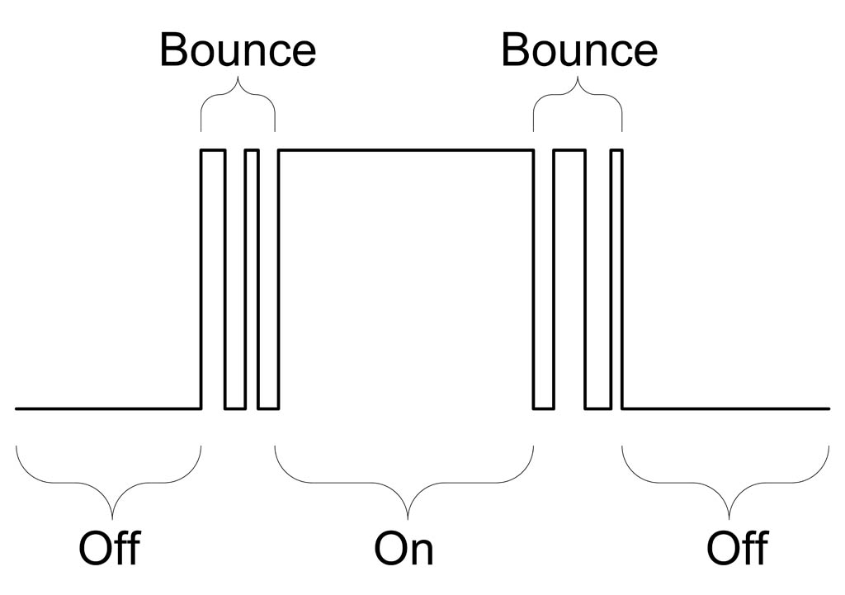
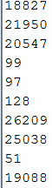
Very small values indicate switch bounce!
Hands On
bounce
One button push!
bounce
bounce
One button push!
bounce
Problem affects most types of switches. It’s everywhere!

Slide 29
Software solution: sleep
Hands On
sleep
sleep
Solution: make computer sleep for 20-40 ms after switch detected. This causes it to ignore bounces.

Slide 30
Debounce Your Program
Hands On
Insert “delay(20);”
Do values make sense now?
void loop() {
long int i = 0;
while (digitalRead(switchPin) == HIGH){}
delay(20); //wait for bounce to stop
while (digitalRead(switchPin) == LOW) {
i = i + 1;
}
Serial.println(i);
delay(20); //wait for bounce to stop
}
Bouncing occurs at front end and back end of button push

Slide 31
for statements e x t r e m e l y useful!
Declare x as an integer if it hasn’t been declared yet
Initialize x
The Test
Increment or decrement
Monitor output:
x equals 0
x equals 1
x equals 2
:
x equals 99
for (int x=0; x<100; x++) {
print(“x equals “);
println(x);
}

Slide 32
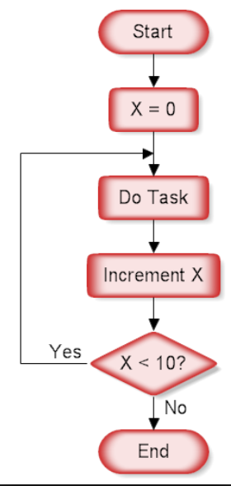
Using a “for” statement
Repeat a task until condition met
for (int i=2; i<8; i++){
pinMode(i, OUTPUT); // “task”
}
Where ”i++” increments “i”
Equivalent to:
Initialize test increment
i=2
i
pinMode(2,OUTPUT);
pinMode(3,OUTPUT);
pinMode(4,OUTPUT);
pinMode(5,OUTPUT);
pinMode(6,OUTPUT);
pinMode(7,OUTPUT);
i<8?
“for” loop flowchart

Slide 33
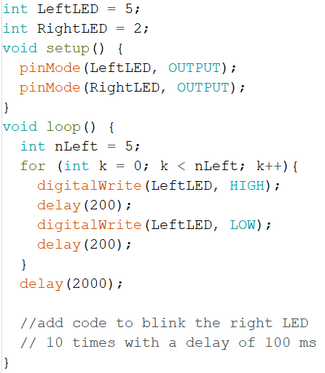
For-loop Practice
Hands On
Open forExampleSkel.ino
Run it: how does it work?
Your Job: Add a second for-loop that blinks Right LED 10 times with a delay of 100 ms
Add Code Here
Solution in forExample.ino
Notes:
forExample.ino

Slide 34
Analog Inputs
Analog-to-Digital Converters
Potentiometers (“Pots”)
Serial Plotter
Pulse Width Modulation (PWM)
RGB LED

Slide 35
Questions
When people talk about “analog” What does that mean?
When people talk about “digital” What does that mean?

Slide 36
Analog and Digital Signals
Digital signals are 0V (“LOW”) or +5V (“HIGH”)
Analog signals vary continuously between 0 and 5V
Where computers live
Where humans live
digital
analog
5V
5V
voltage
voltage
0V
0V
time
time
How can we communicate between these worlds?

Slide 37
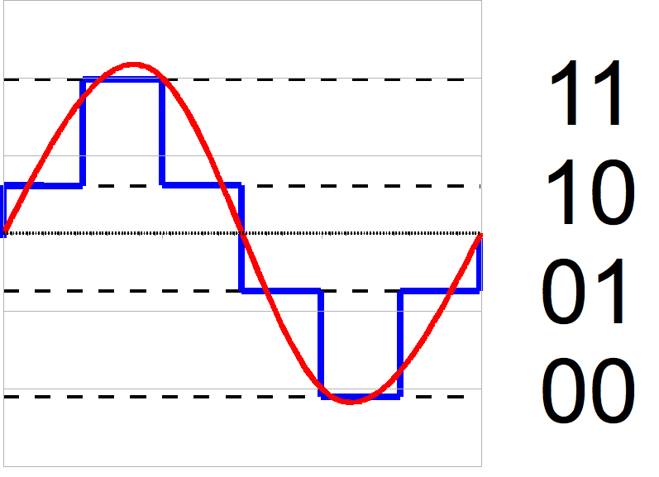
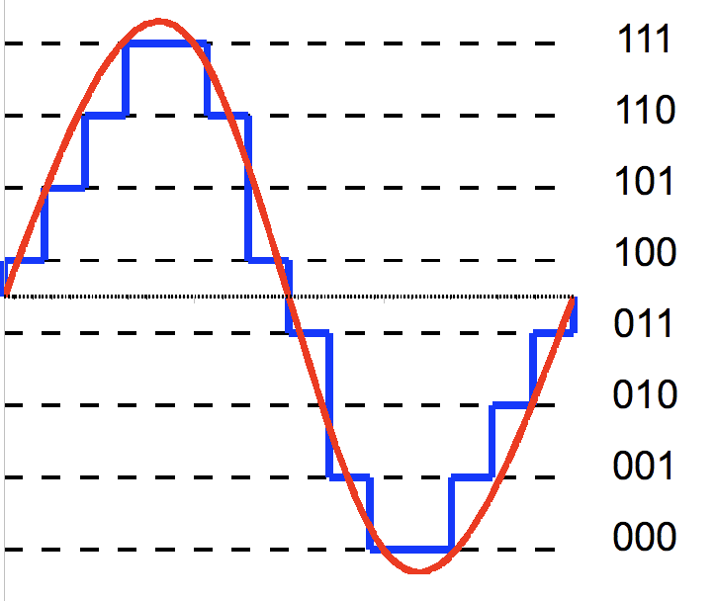
Analog-to-Digital Converter “ADC”
Some arbitrary analog signal like speech
binary
decimal
binary
7
Eleven
6
5
Ten
4
3
One
2
1
Zero
0
2-bit ADC
2² = 4 values
3-bit ADC
2³ = 8 values
Analog voltage is measured at Arduino input pin
Converted to Digital value used in Arduino sketch
Quiz question: would you rather have 100 (binary) doughnuts or 6 (decimal) doughnuts?

Slide 38
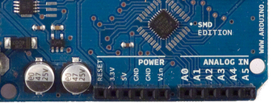
Analog Inputs
Arduino Uno has six ADC input pins
A0, A1, A2, A3, A4, and A5
These can also be used as digital input/outputs
Input voltages between 0 and 5 volts
ADC value is 10 bit integer
There are 2¹⁰ = 1024 possible integer values
Values range from 0 to 1023

Slide 39

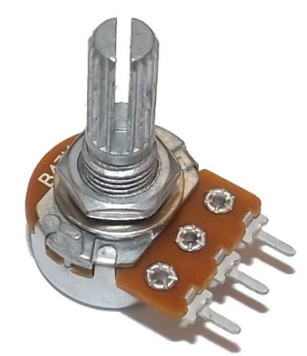
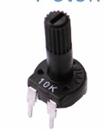
Potentiometer (“Pot”)
We’ll use it to generate an analog signal
A water spigot varies the water pressure
A pot varies the voltage
Turn the knob and change the resistance to flow
Find yours in your kit…
Comes in the kit as two pieces
Came in the big bag
Not the best quality…
These are nice

Slide 40
Potentiometer or “pot”
“Wiper”
Knob turns the Wiper
+5 V
Resistive material
Wiper voltage
Wiper Output
0 V
Wiper voltage depends on position of knob
Voltage decreases as current flows through resistive material
Therefore, wiper voltage controlled by knob rotation
Example: volume control in audio equipment

Slide 41
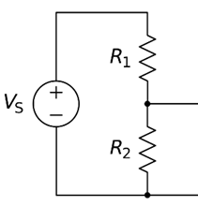
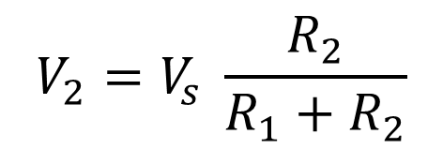
This is called a “Voltage Divider” circuit
Voltage is “divided” into two parts
Some is across R₁, the rest is across R₂
Provides a way us to control voltage
Current enters R₁ with voltage V_{s}
It loses energy as it passes through R₁
Voltage drops from V_{s} to V₂
It loses the remainder of its energy passing through R₂
Voltage drops from V₂ down to zero, also known as “Ground”
Result: R₁ and R₂ control the voltage V₂
current
Arduino
V₂
A0
Battery or Arduino
GND

Slide 42
Hands On
Objective: Understand analog inputs
Voltage divider and potentiometer
Serial Plotter (not available on Arduino Create)
Pulse Width Modulation (PWM)

Slide 43
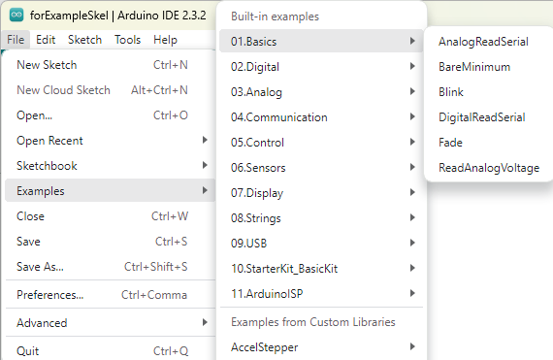
Get a Built-in Example
Hands On
Click: File -> Examples -> Basics -> AnalogReadSerial

Slide 44
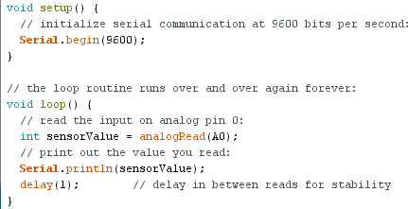
Experiment
Hands On
How this C program works…
First: change delay from 1 to 100 ms
makes output slower and easier to read
Change to 100

Slide 45
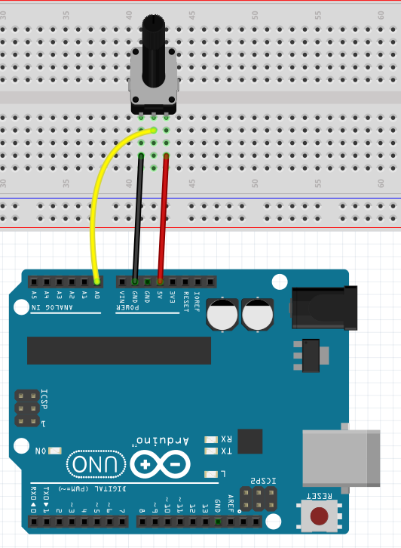

Use the Metal Pot (if you have one)
Hands On
Good Pot
(courtesy of UW!)
Push in hard!
(don’t be gentle)

Slide 46
Upload the Sketch
Hands On
Turn on Serial Monitor.
Rotate the potentiometer
Confirm that values range between 0 and 1023

Slide 47
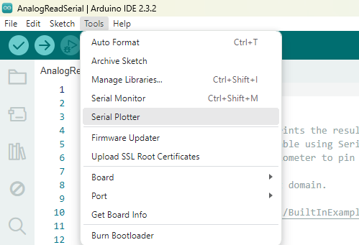
Serial Plotter
Hands On
Exit from Serial Monitor (click the “X” button)
Start the Serial Plotter (tools
Turn the Potentiometer knob

Slide 48
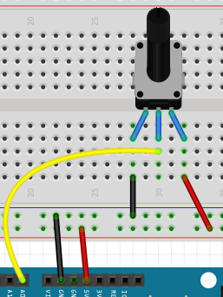
What We Learned
Hands On
Arduino can measure a voltage
Possibly from a sensor like a photo-resistor
Or from a potentiometer
The voltage reading is an integer between 0 and 1023
Now we can write an Arduino program that makes decisions based on the measured value in some intelligent way

Slide 49
Pulse Width Modulation (PWM)
Controlling the brightness of an LED or the speed of a motor using analogWrite()

Slide 50
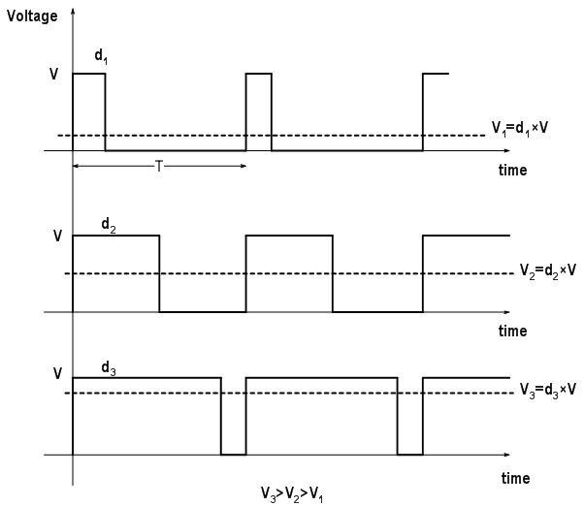
analogWrite(): It’s not Analog!
analogWrite(pinNo, value);
You would think that the output voltage is “value”
But you’d be wrong
Outputs 5V or 0V to pinNo
This is a digital signal
Average voltage is determined by “value”

Slide 51
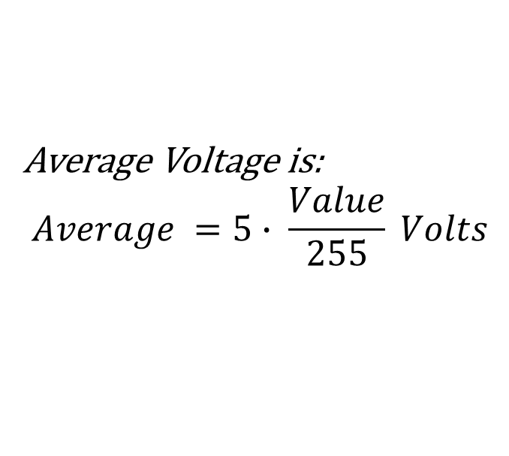
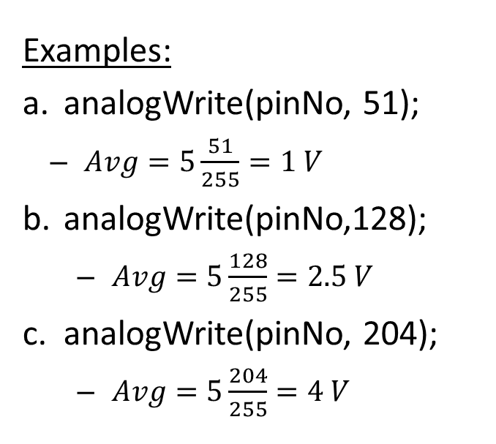
PWM Controls Average Voltage
Average Voltage is:
$$Average =5∙ \frac{Value}{255} Volts$$
Examples:
analogWrite(pinNo, 51);
$Avg=5\frac{51}{255}=1 V$
analogWrite(pinNo,128);
$Avg=5\frac{128}{255}=2.5 V$
analogWrite(pinNo, 204);
$Avg=5\frac{204}{255}=4 V$

Slide 52
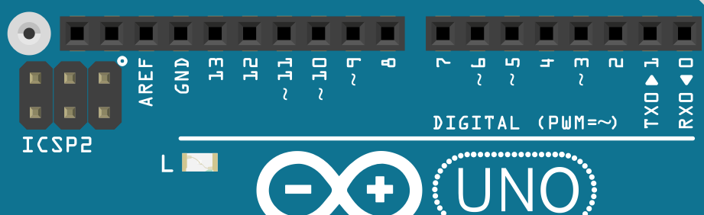
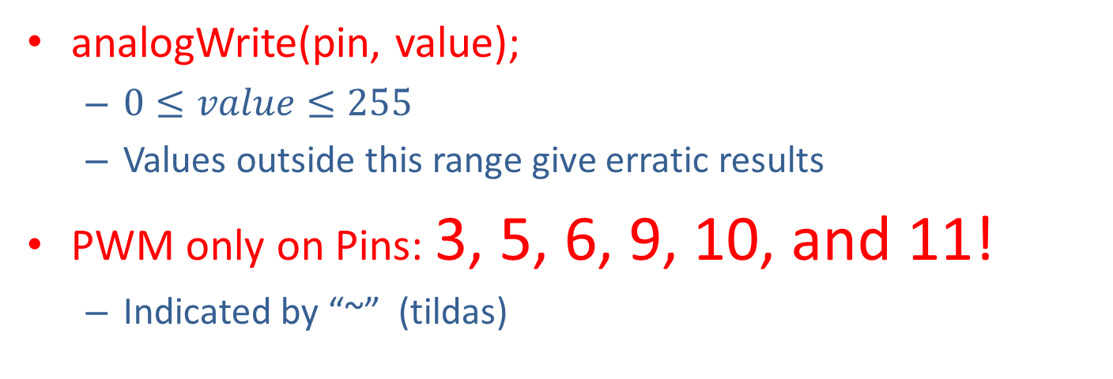
PWM Restrictions
analogWrite(pin, value);
$0≤value≤255$
Values outside this range give erratic results
PWM only on Pins: 3, 5, 6, 9, 10, and 11!
Indicated by “~” (tildas)

Slide 53
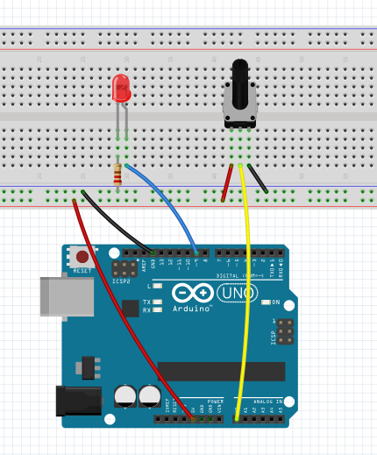
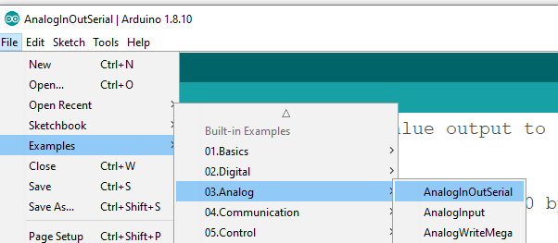
Try it
Hands On
Perceived brightness changes even though voltage is only 0 or 5V
Connect LED + resistor to pin 9
Pot to pin A0
Use Built-in Example: Examples–>Analog->AnalogInOutSerial
9
A0

Slide 54
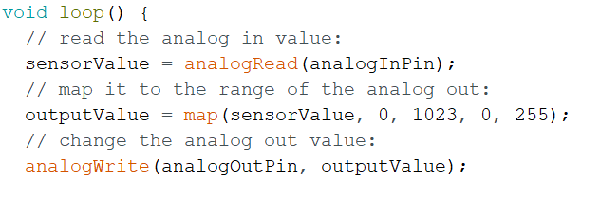
Hands On
How it works
Potentiometer: sensorValue is between 0 and 1023
Map: converts value to a number between 0 and 255
analogWrite: Outputs PWM signal to LED
PWM is also used to control the speed of dc motors

Slide 55
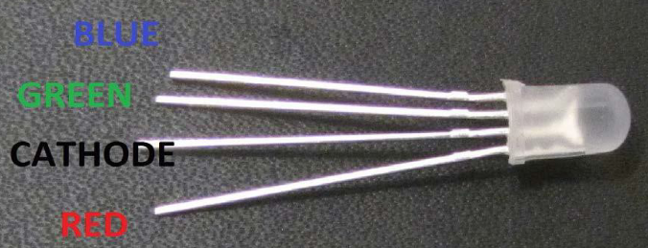
Using PWM with an RGB LED
What is an RGB LED?
“LED” = Light Emitting Diode, “RGB” = Red, Green, Blue
An RGB LED contains a red, green, and blue LED used to create different colors
A RGB LED has four pins: one for ground and one for each color
Can think of making colors in a RGB LED like mixing paint
Different amounts of red, green, and blue paint can produce different colors. Use different amounts of red, green, and blue light to accomplish the same thing!

Slide 56
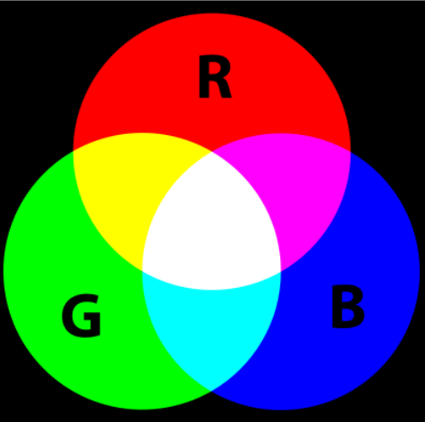
What is an RGB LED?
A common way to represent colors is using the RGB triplet. The values can range from 0 to 255, with 255 being the maximum value. For example:
Red = (255, 0, 0)
Green = (0, 255, 0)
Blue = (0, 0, 255)
Purple = (255, 0, 255)
White = (255, 255, 255)
We can also use PWM to vary the brightness, or amount of light, that gets used to create each color → different shades
To keep it simple we will only use PWM to vary the brightness of the LED and not create different shades in this module

Slide 57
Hands On
Objective:
Build simple circuit using the RGB LED
Use PWM to cycle through various colors on the RGB LED

Slide 58
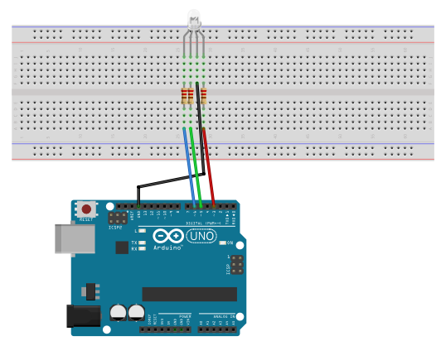
Build this Circuit
Hands On
The longest pin on the RGB LED is the GND
Use the picture below to distinguish which pin controls with color

Slide 59
Your Assignment:
Hands On
void loop() {
// Write code that increases the red pin
// from 0 to max brightness then decreases
// it to 0. This will cause the LED to flash red
// increment/decrement by 5
for (outputValue = 0; outputValue < 256; outputValue +=5)
{
analogWrite(analogOutRed, outputValue);
delay(10);
}
for (outputValue = 255; outputValue >=0; outputValue -=5)
{
analogWrite(analogOutRed, outputValue);
delay(10);
}
}
Open RGB_LED.ino from Templates folder
Edit it to increase and decrease the value on the Red LED
Does it do what you expected?

Slide 60
RGB LED code
Hands On
The block of code we created will cause the RGB LED to flash red on and off.
Now duplicate the code so that the RGB LED will also cycle through green and blue.
Challenge: add some more colors to the forever loop by changing which Color Pins are changed by PWM. You can view the full code in the completed code directory.
Hint: The color combinations that we can create are:
Yellow → (255, 255, 0)
Purple → (255, 0, 255)
Teal → (0, 255, 255)
White → (255, 255, 255)

Slide 61
Practical Use of analogInput Make a Voltmeter and an Ohm meter
Optional Projects if We Have Time
Converting ADC value (0 to 1023) into a physically meaningful number
Learning about Floating Point variables

Slide 62

Convert analogRead() to Volts
We know that: 0 ≤ analogRead ≤ 1023
Let’s Convert it to: 0 ≤ Voltage ≤ 5
Formula: $Voltage=\frac{5}{1023}×analogRead$
5
Actual Voltage (volts)
(we want this)
0
0
1023
analogRead value
(we have this)

Slide 63
Voltmeter Sketch
Start with same circuit as before
Open the Built-In example program
Basics -> AnalogReadSerial
Save As new file: Voltmeter
We’ll modify this program to be a Voltmeter

Slide 64
“Floating Point” Variables
Integer variables will not store fractions
“Floating Point” variables store fractional values
Add the following lines to the end of loop()
Place code just before the final right curly bracket
Converts integer sensorValue to floating point V
float V = 5.0*sensorValue/1023.0;
Serial.print(“Voltage: “);
Serial.println(V); //print V and begin new line

Slide 65
Hands On
Objectives:
Voltmeter Experiments
Ohmmeter Experiments
Final project: ohmmeter plus LED display

Slide 66
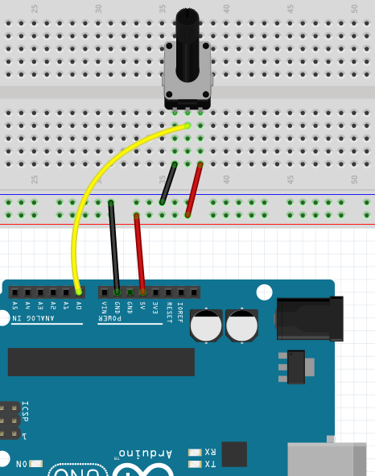
Experiment #1
Hands On
Turn on Serial Monitor or Plotter
Measure voltage on pin A0 as you turn potentiometer
You should see values between 0 and 5 Volts
A0

Slide 67
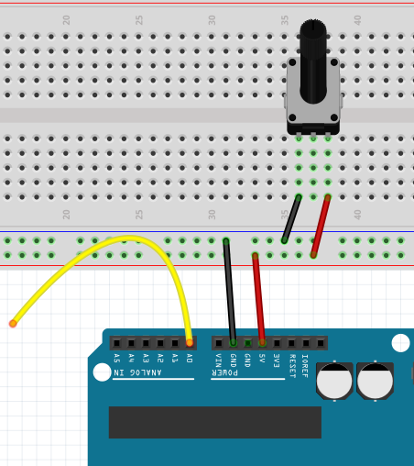
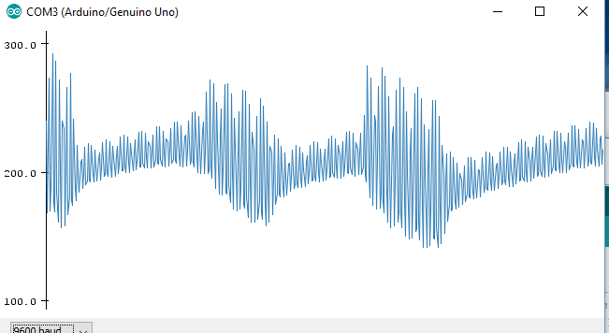
Experiment 2: Floating Input
Hands On
Recall: An unconnected pin is called a “floating input”
Unplug the wire to the pot
The wire connected to A0 now hangs free in the air
We say that A0 is “floating” (usually a BAD thing)
Activate Monitor (or Serial Plotter if you’re using Desktop IDE)
Move your finger on and off of the wire to A0
Result depends on your location
floating input
Random Noise!!!!

Slide 68
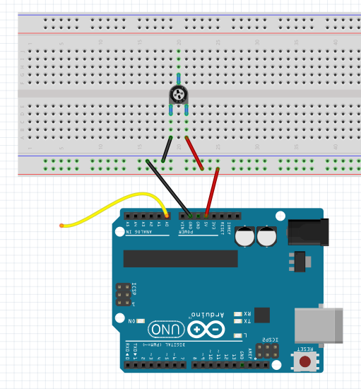


Experiment #3
Hands On
Use your voltmeter to measure button battery
Works on any battery as long as $0≤V≤5 Volts$
Jumper
Pot
Not used
Jumper
Button Battery

Slide 69
Next Project: Build an Ohmmeter
Hands On
Tired of identifying 220, 1K, and 10K ohm resistors?
Wouldn’t it be nice if you could just measure the resistance?
Arduino cannot directly measure resistance
Must use a voltage divider to convert resistance to voltage

Slide 70
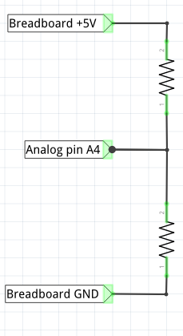
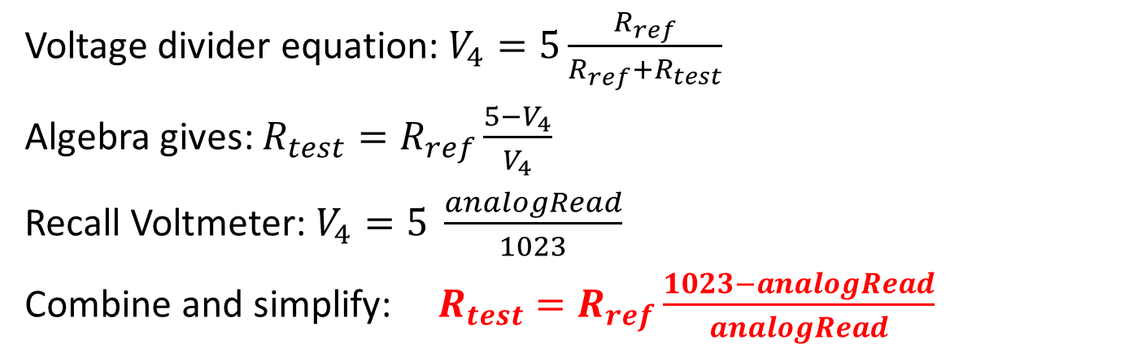
Theory of Operation
Hands On
Unknown resistor
R_{test}
R_{ref} is Any known resistor
V₄ is voltage measured on pin A4
Any analog input would work: A0, A1, …, A5
Solve for unknown resistor R_{test}.
V₄
Known resistor
R_{ref}
Voltage divider equation: $V_{4}=5\frac{R_{ref}}{R_{ref}+R_{test}}$
Algebra gives: $R_{test}=R_{ref}\frac{5−V_{4}}{V_{4}}$
Recall Voltmeter: $V_{4}=5 \frac{analogRead}{1023}$
Combine and simplify: $R_{test}=R_{ref}\frac{1023−analogRead}{analogRead}$

Slide 71
Make a New Sketch: OhmMeter.ino
Hands On
Save your Voltmeter sketch as a new sketch called OhmMeter
We’ll edit the sketch to convert it into an ohm-meter
Following slides contain the basic changes

Slide 72
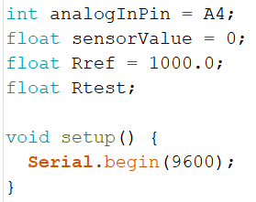
Create the OhmMeter sketch
Hands On
Enter the following C commands at the top:

Slide 73
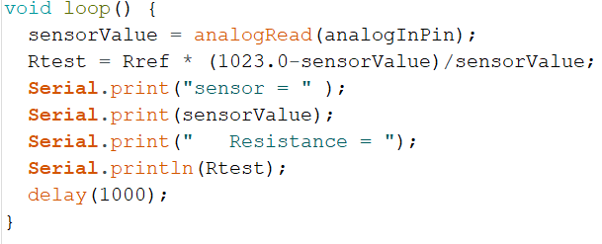
OhmMeter.ino (cont’d)
Hands On
Keep typing:

Slide 74
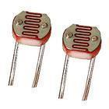
Your Job:
Hands On
Build the circuit using R_{ref}= 1000 Ohm
Upload the sketch
Open Serial Monitor
Test different resistors
Test a 220, 1000, and 10,000 Ohm resistor
How is the accuracy?
Also measure resistance of a photo-resistor (in light and in shadow)

Slide 75
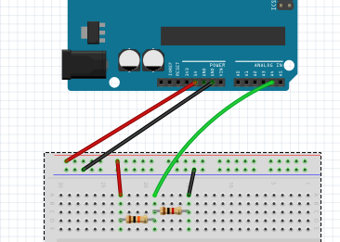
The Ohmmeter Circuit
Hands On
Unknown
Resistor R_{test}
R_{test}
V₄
R_{ref}=1000
R_{ref}= 1000
A4
Reference
Resistor

Slide 76
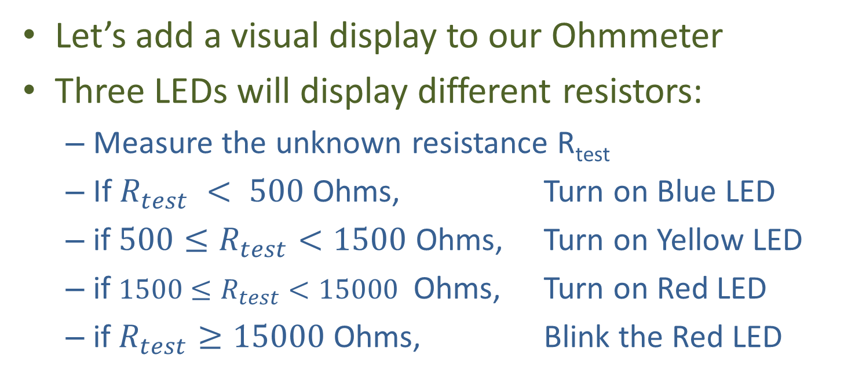
Final Project (if you have time): Ohmmeter + LED Display
Hands On
Let’s add a visual display to our Ohmmeter
Three LEDs will display different resistors:
Measure the unknown resistance R_{test}
If $R_{test} < 500$ Ohms, Turn on Blue LED
if $500≤R_{test}<1500$ Ohms, Turn on Yellow LED
if $1500≤R_{test}<15000$ Ohms, Turn on Red LED
if$R_{test}≥15000$ Ohms, Blink the Red LED

Slide 77
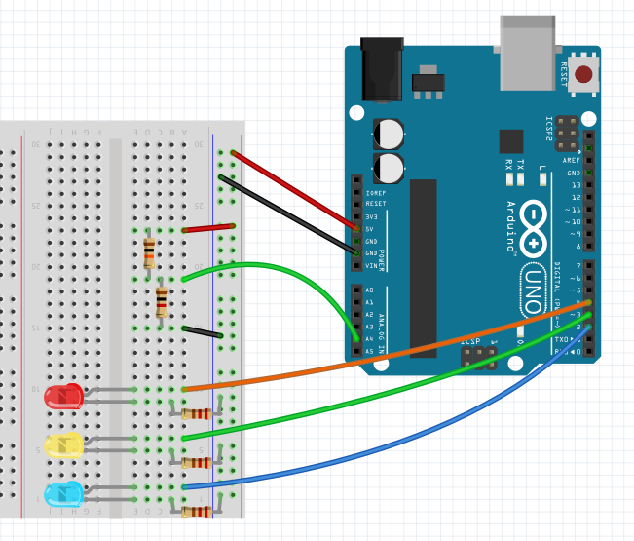
The Modified Circuit
Hands On
R_{ref}
R_{ref}=1000

Slide 78
Modifications to setup()
Hands On
LEDs are connected to pins 2, 3, 4
So you need to add pinMode statements to setup
E.g., pinMode(2, OUTPUT);
Additional pinMode statements are required for pins 3 and 4
You can access the following sketches
OhmMeterPlusSKEL.ino (skeleton code)
OhmMeterPlus.ino (full code)

Slide 79
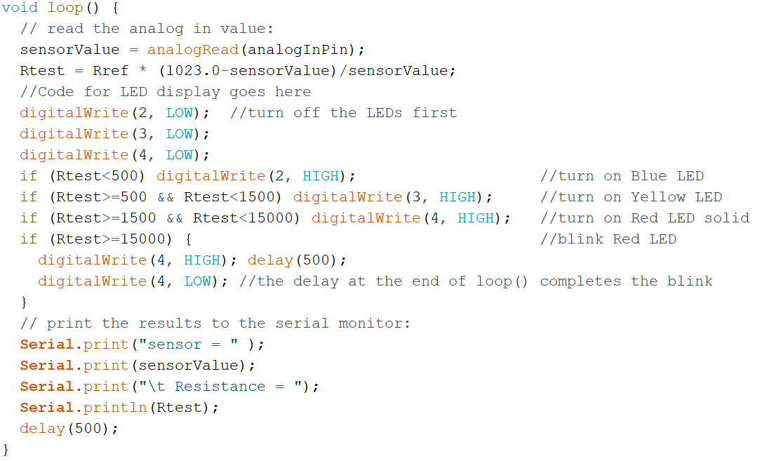
Modifications to loop()
Hands On
Add this code

Slide 80
Your Assignment
Hands On
Understand the code
Open skeleton code: OhmMeterPlusSKEL.ino
Edit to make the changes shown above
Test circuit with:
220 Ohm
1K Ohm
10K Ohm
100K Ohm
Photoresistor, in light and in shadow

